Slide 1
Cancer Survival Rates in the USA
Presented by Ruth Holley and Sam Lam June 2019

Slide 2
Background
The purpose of this project is to compare cancer ( Breast, Lung and bronchus, skin, Brain and nervous system, colon, and rectum ) survival rates in five different decades ( 1973, 1983, 1995, 2006, 2013 ). Then provide a further breakdown to view the survival rate for male and female. We will try to determine whether there are certain types of cancer that might be driving up in certain years.

Slide 3
Why are we interested in this topic?

Slide 4
Analysis
1.Which are the top five cancers that are more prevalent in the United States population?
2. Which types of cancer affects mostly women versus men?
3. Which type of cancer has the highest survival rate in both genders?
4. Has the survival rate increase over a mostly 10 years interval?
5. Is race a factor in cancer survival rate?

Slide 5
Methods
We used R programming, specifically Dplyr package to perform the necessary data manipulation and aggregations. Moreover,ggplot and ggplot2 and base R method are also used to generate our graphs and tables.

Slide 6
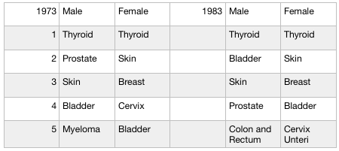
Types of cancer with the highest survival rate in both genders

Slide 7
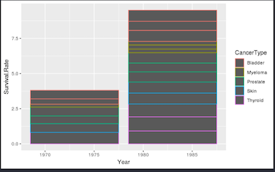
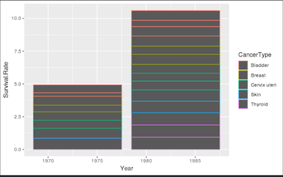
Male Female

